Slide 1
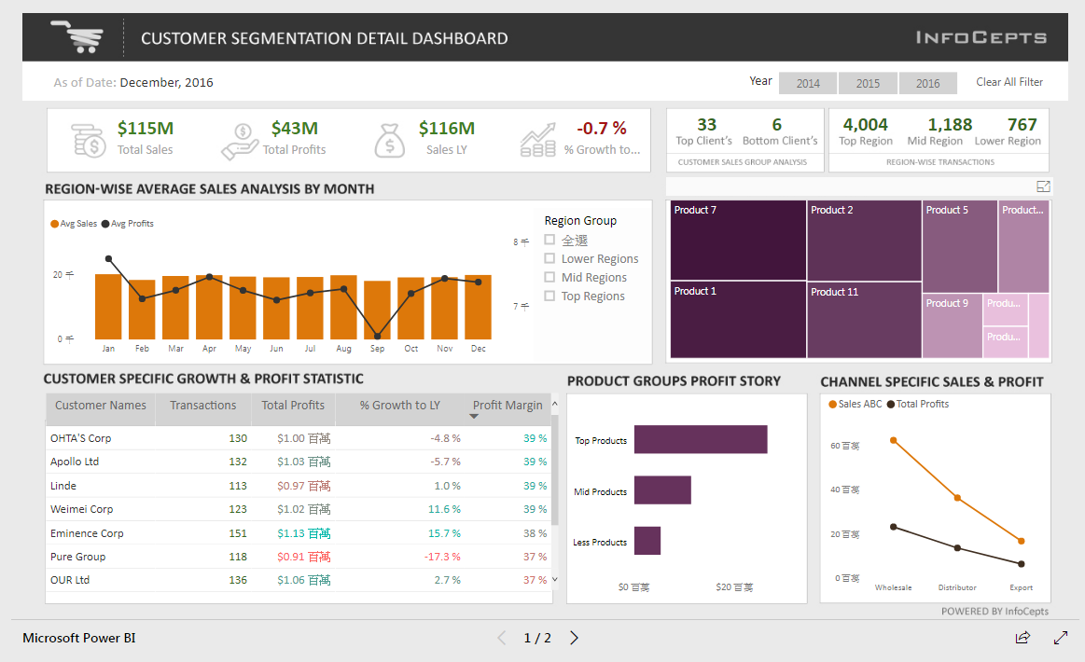
Business Intelligence Produce an interactive dashboard to explore data

Slide 2
What is power bi desktop?
Power BI Desktop is a free application you can install on your local computer that lets you connect to, transform, and visualize your data.
With Power BI Desktop, you can connect to multiple different sources of data, and combine them (often called modeling) into a data model that lets you build visuals, and collections of visuals you can share as reports, with other people inside your organization.

Slide 3
Most common uses for power bi desktop
Connect to data
Transform and clean that data, to create a data model
Create visuals, such as charts or graphs, that provide visual representations of the data
Create reports that are collections of visuals, on one or more report pages
Share reports with others using the Power BI service

Slide 4
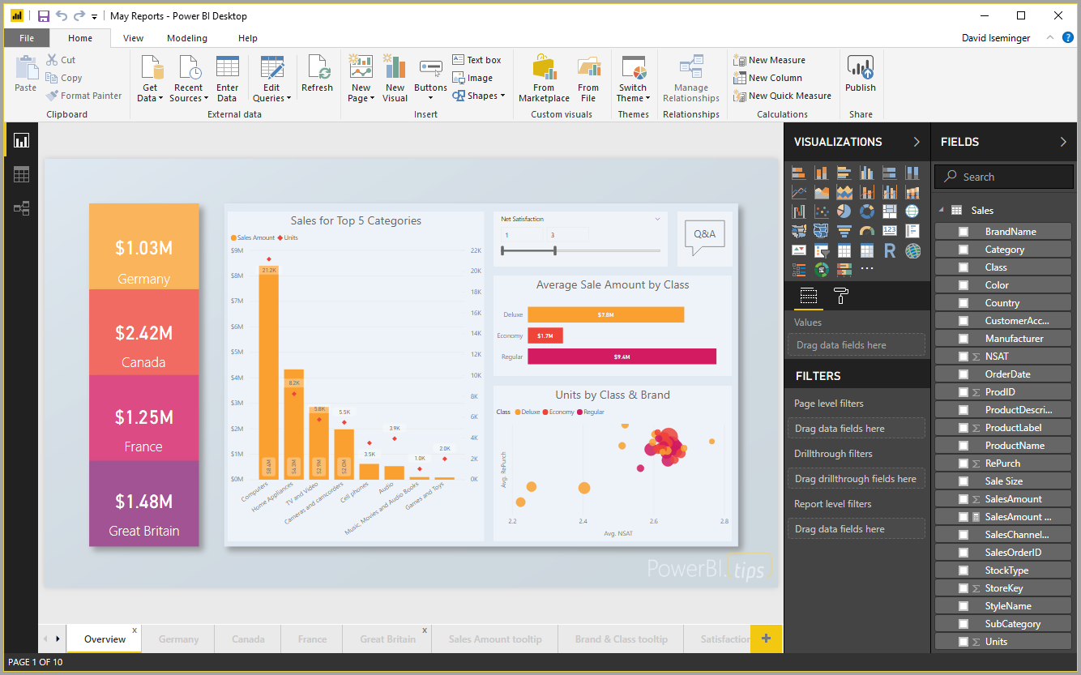
Five Steps to Build an Interactive dashboard

Slide 5
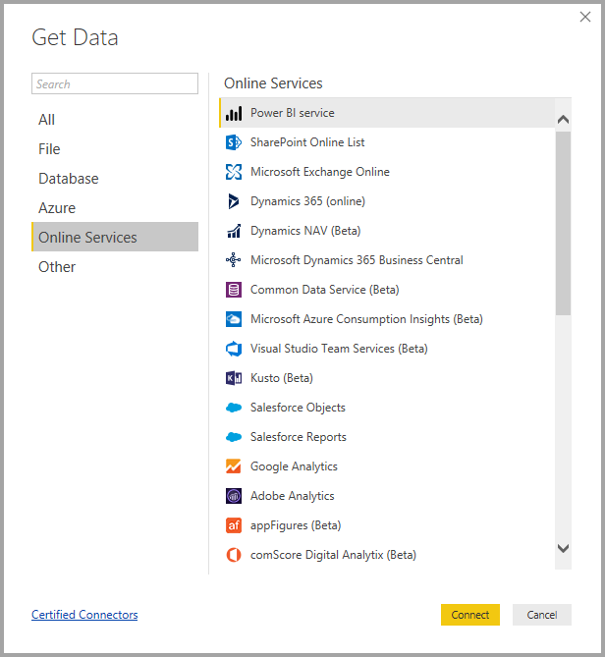
1) Connect to data
To get started with Power BI Desktop, the first step is to connect to data. There are many different data sources you can connect to from Power BI Desktop.

Slide 6
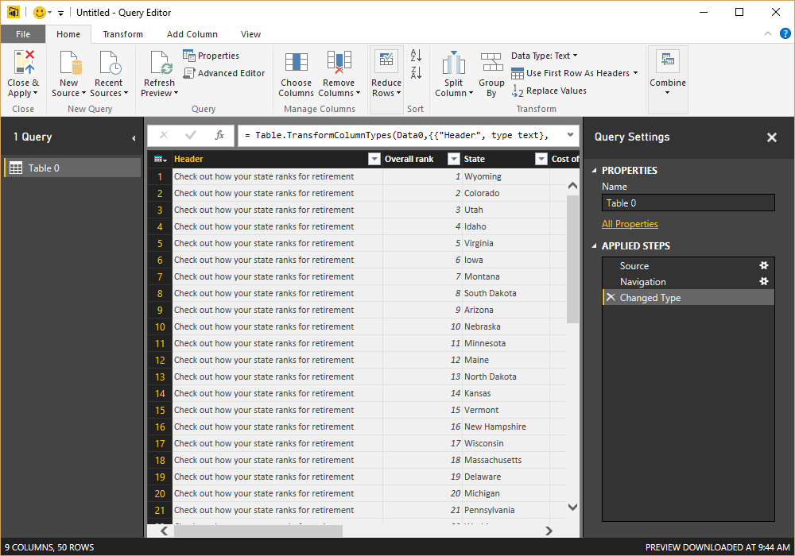
2) Transform and clean data, create a model
In Power BI Desktop, you can clean and transform data using the built-in Query Editor. With Query Editor you can make changes to your data, such as changing a data type, removing columns, or combining data from multiple sources.

Slide 7
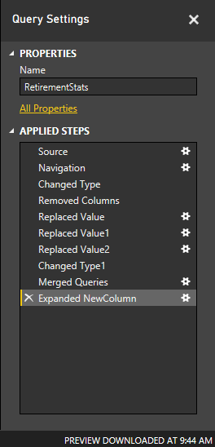
2) Transform and clean data, create a model
Each step you take in transforming data (such as rename a table, transform a data type, or delete columns) is recorded by Query Editor.

Slide 8
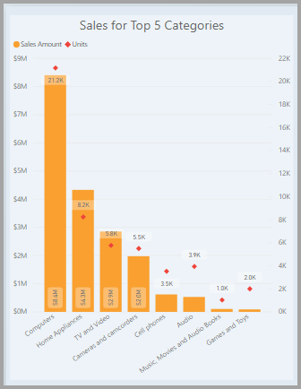
3) Create visuals
Once you have a data model, you can drag fields onto the report canvas to create visuals. A visual is a graphic representation of the data in your model.

Slide 9
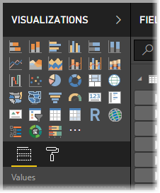
3) Create visuals
There are many different types of visuals to choose from in Power BI Desktop. To create or change a visual, just select the visual icon from the Visualizations pane.

Slide 10
4) Create reports
More often, you'll want to create a collection of visuals that show various aspects of the data you have used to create your model in Power BI Desktop. A collection of visuals, in one Power BI Desktop file, is called a report.

Slide 11
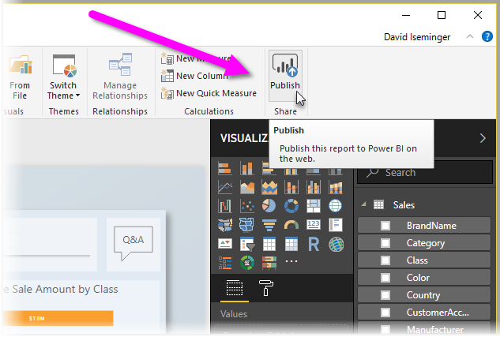
5) Share reports
Once a report is ready to share with others, you can Publish the report to the Power BI service, and make it available to anyone in your organization who has a Power BI license.

Slide 12
What is power bi desktop?
For more information, you can visit:
https://slideplayer.com/slide/10664973/
You may also try the following interactive dashboards that were built by Power BI:
https://community.powerbi.com/t5/Data-Stories-Gallery/Cancer-Analytics/m-p/631080
https://community.powerbi.com/t5/Data-Stories-Gallery/Customer-Analysis-Dashboard/m-p/630893

Slide 13
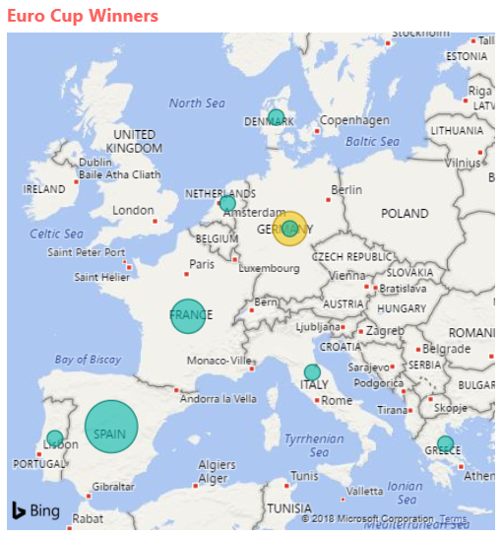
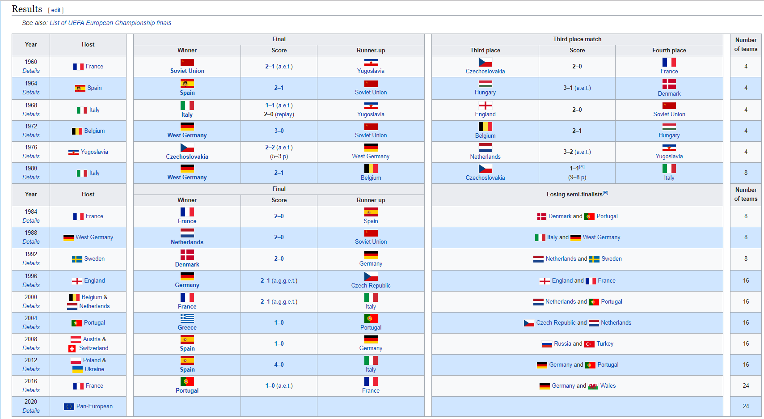
BI Exercise
Analyze web page data using Power BI Desktop to show the UEFA European Championship (Euro Cup) winners over the years.
Web data source
http://en.wikipedia.org/wiki/UEFA_European_Football_Championship
Map visualization

